Slide 1
Not So Shiny Things that I learned about shiny, the “hard way”
October 2019

Slide 2
Adi Sarid
Professional: Market Research, Data Scientist, Operations Research, Educator
Academia: Mathematics, Statistics and Operations Research (Bsc, MA, Phd-in-process)
Software: R, Python

Slide 3

What inspired this talk? A Nasty Situation
A few years ago, I promised a client I will build something (sort of a small CRM)
It took me much more time, effort, and a few production emergencies
I decided to learn from this experience (and other experiences), and share some know-how

Slide 4
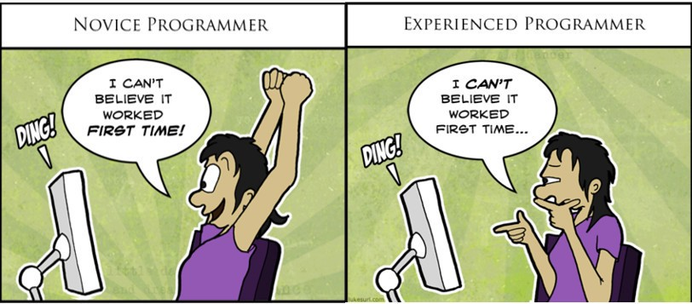
What’s not so shiny? depends…
Newbie
Intermediate
Advanced
Just starting to play with shiny
This is so cool, you can actually build stuff
You rock! Shiny rocks!

Slide 5
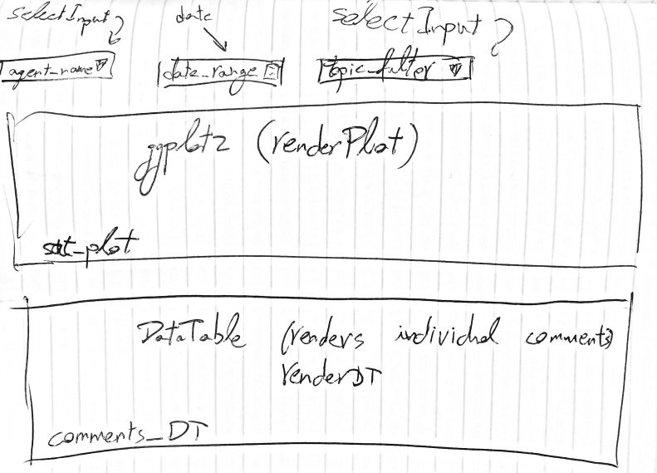


Newbie, Not So Shiny #1: Don’t rush into doing stuff
Invest in proper planning while you work, e.g.:
Build/draw a mockup.
Research.
Usually there is more than one solution to your challenge
Example 1: DataTable vs. handsontable
Example 2: base r vs. ggplot2 vs. plotly vs. r2d3 vs. …?
Read a lot.
mastering-shiny.org
stackoverflow
code/research widgets/app.R

Slide 6
Newbie, Not So Shiny #2: Not (truly) understanding reactivity
As a newbie, I just looked at a lot of examples and tried to copy the techniques in the examples.
However, doing so, I lacked an in-depth understanding of what is reactivity and how it works.
For example, what is the difference between:
reactive
reactiveVal
reactiveValues
eventReactive
observe
observeEvent
code/reactivity tricks/app.R
Notes:
reactive() creates a reactive function (with dependencies). Usually this would be an “in-between” the inputs and outputs. Should be created once in the code and not touched further up.
reactiveVal() and reactiveValues() create a function which acts like a value (or a list of values). It is used to “describe a state”. Can be updated within the app, for example in observe or observeEvent calls. Using these is risky and needs a bit of a better higher understanding of reactivity, because it can create an infinite reactivity loop.
eventReactive() creates a reactive function, just like reactive(), only that it waits till some event occurs in the app (like a button click).
observe() and observeEvent() do some reaction following something that happened in the app. contrary to reactive() and eventReactive() they don’t return anything.

Slide 7
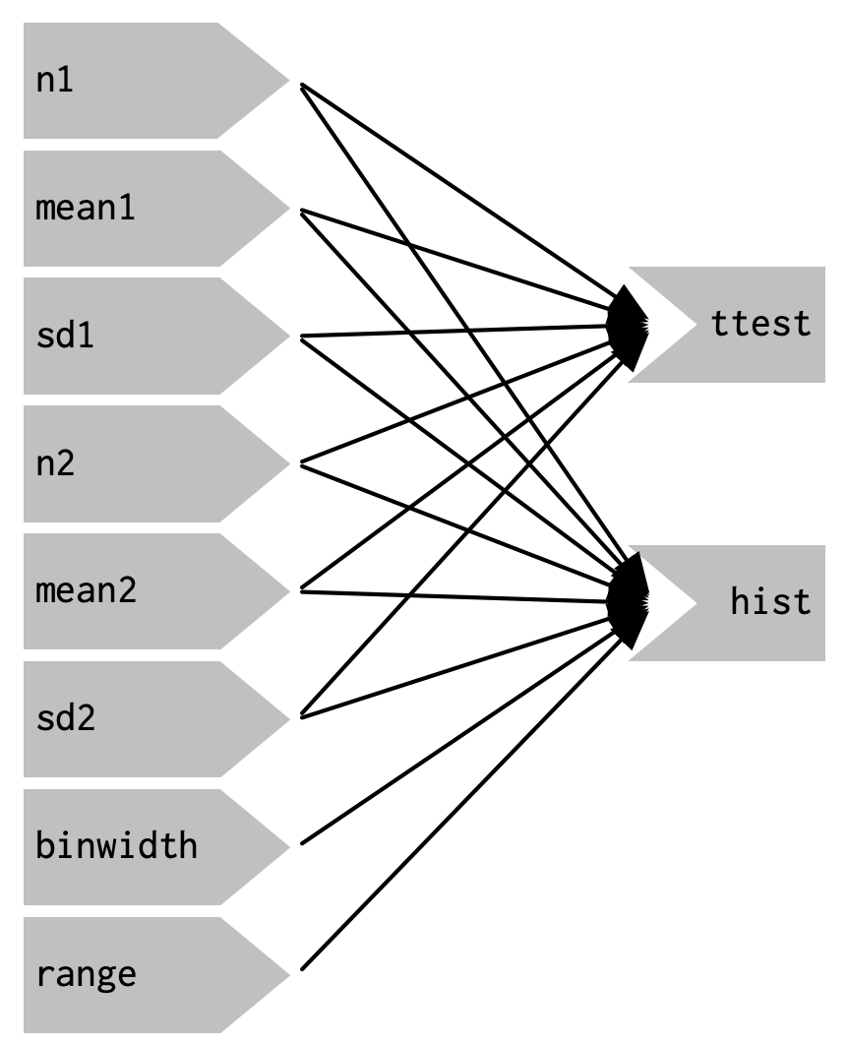
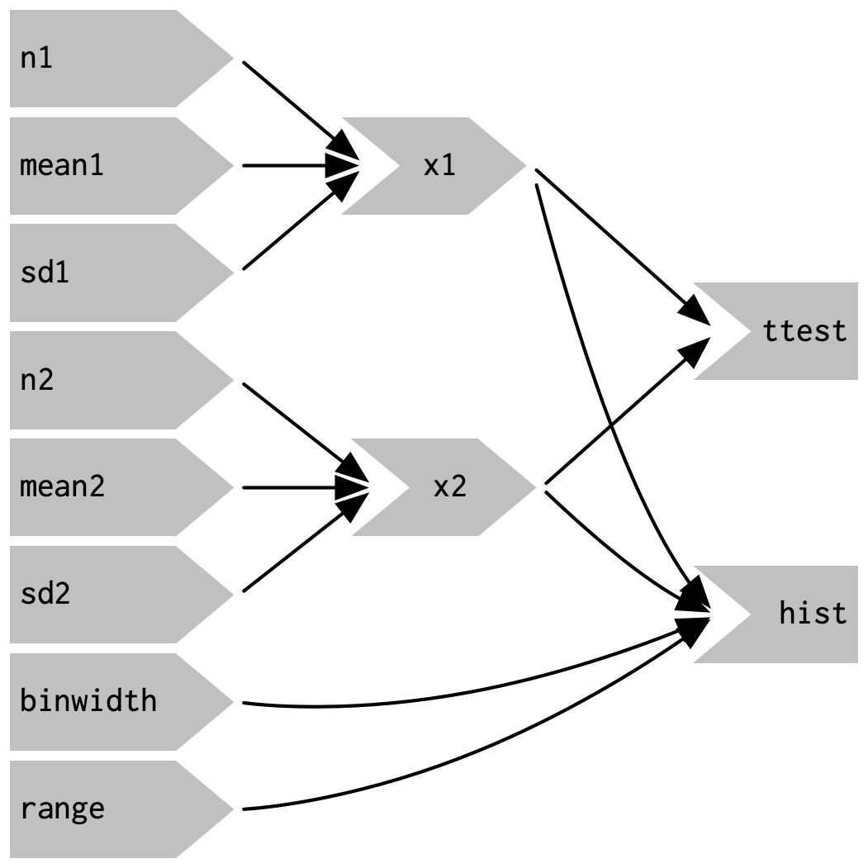
From mastering-shiny.org )chapter 4(
(and also, chapters 13-16)

Slide 8
Intermediate, Not So Shiny #3: Not thinking like a software engineer
As you grow, your projects get more complex and (hopefully) someone is paying you for them
You need to start thinking like a software engineer (and not just as the data scientist you are).
For example here are some “non-data science” questions:
Are you using a Dev -> Test -> Stage -> Production cycle?
Are you working in agile or waterfall?
Are you automating your tests? (unit testing)
Are you planning budget? (e.g., for AWS resources)
The list goes on and on….

Slide 9
Intermediate, Not So Shiny #4: Not splitting your code to modules
Ever think about a world without functions? I couldn’t either.
When your app gets complex, you should use modules: splits recurring input-output into basic units (just like functions split recurring actions)
Original app:
The module (behind the scenes)
Very long UI
App using module:
One liner UI function
Very long server
One liner server function
code/modules/app.R

Slide 10
Advanced, Not So Shiny #5: Not sharing what you learned
At an advance level, be sure to spread the 💕 and help others
(Actually this is true in general, not just shiny)
Blog about stuff
Present/show up for meetups
Answer stackoverflow questions
Develop open source packages
Discussions on FB…

Slide 11
Some related resources
This presentation and all the live-coding apps are available
https://github.com/adisarid/meetup_not_so_shiny
Learn from your mistakes – tidyverse (Hadley Wickham)
https://www.youtube.com/watch?v=vYwXMnC03I4
Mastering-shiny.org
A must read book. Currently in draft, set for release during 2020

Slide 12


Thanks! We’re hiring. Ask me about it.
Adi Sarid
adi@sarid-ins.co.il
@SaridResearch
https://www.sarid-ins.co.il
https://adisarid.github.io

